Slide 1
SHIFT4IT
Shifting the paradygm for women in IT sector

Slide 2
Information Architecture

Slide 3
Summary
In this lesson, you will explore the fundamentals of Information Architecture (IA)—the practice of organizing, structuring, and labeling content in a clear and meaningful way.
Information Architecture will help users find what they need quickly and efficiently by enabling logical navigation systems, intuitive site structures, and well-organized content.
You will cover key IA elements such as:
User flows and task paths
Sitemaps and navigation menus
Content hierarchy and categorization
Labeling systems and taxonomy
A solid IA will improve usability, reduce user frustration, and enhance the overall experience by making digital products easier to understand and navigate.
By the end of the lesson, you will understand how IA supports UX design and plays a crucial role in building user-centered interfaces.

Slide 4

Introduction to Information Architecture
Information architecture (also known as IA) is the process by which content is organized and made readily available to users.
Information architecture focuses on organizing and structuring content to make it easily accessible, while UX design is broader, focusing on creating a positive and meaningful user experience through intuitive interfaces and interactions.
Source: http://makeameme.org

Slide 5
Introduction to Information Architecture
Don’t forget:
Who will be using a product?
What are they going to do?
What do they want to achieve?
IA
Users: who are we talking to?
Content: what information are we providing
Context: how will they interact with content
Users
Who are talking to?
IA
Content
What information
Are we provinding?
Context
How will they
Interact with content?

Slide 6
Introduction to Information Architecture
IA helps to
Increase conversion rates: New users can more easily find the information they need, and purchases can be streamlined.
Reinforce credibility: A clean and well-organized website increases consumer confidence.
Improve productivity: Employees know where different types of content belong and can more readily build out new pages as necessary.
Boost SEO: Good site-level organization is a key factor in search engines’ algorithmic rankings.
Reduce customer service costs: Users can better troubleshoot their problems when a website surfaces the right information to them at the right time.

Slide 7
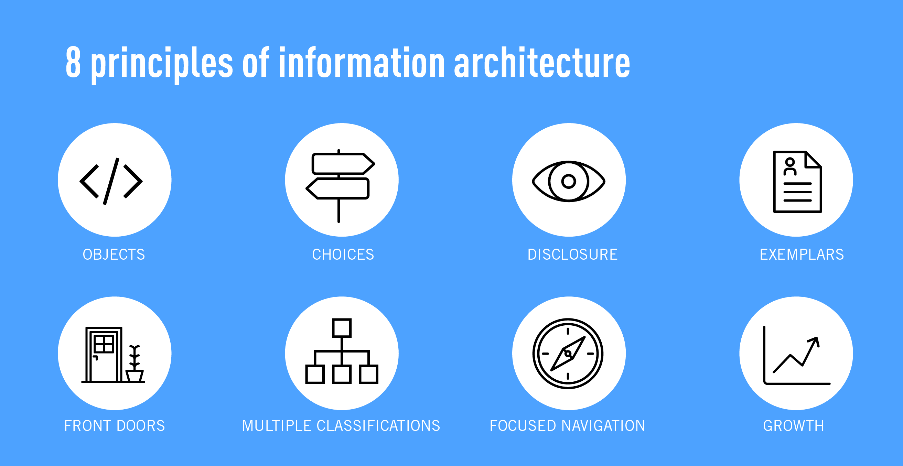
Introduction to Information Architecture
Building the information architecture for a website should not be done in a vacuum. From user behavior, to future-proofing, there are lots of things to take into account, beyond organizing the information in a logical way.
Source: https://medium.com/
Back in 2010, Dan Brown, the brain behind EightShapes, laid down eight principles for information architecture to guide designers in their choices.

Slide 8
Introduction to Information Architecture
The principle of objects: Content should be treated as a living, breathing thing. It has lifecycles, behaviors, and attributes.
The principle of choices: Less is more. Keep the number of choices to a minimum.
The principle of disclosure: Show a preview of information that will help users understand what kind of information is hidden if they dig deeper.
The principle of exemplars: Show examples of content when describing the content of the categories.

Slide 9
Introduction to Information Architecture
5. The principle of front doors: Assume that at least 50% of users will use a different entry point than the home page.
6. The principle of multiple classifications: Offer users several different classification schemes to browse the site’s content.
7. The principle of focused navigation: Keep navigation simple and never mix different things.
8. The principle of growth: Assume that the content on the website will grow. Make sure the website is scalable.

Slide 10
How to Create a Website Information Architecture
Step by step
1. Define Key Stakeholders' Goals
Identify the main objectives of the website.
Determine the primary and secondary audiences.
List functional requirements (e.g., search tools, downloadable content, forms).
2. Identify User Goals
Understand what users expect to find.
Conduct user research or interviews.
Organize content based on user needs rather than internal structures.

Slide 11
How to Create a Website Information Architecture
3. Define Site Content Areas
Review existing content and decide what to keep, update, or remove.
Identify new content users will need.
4. Organize Content into Groups
Use card sorting or post-it exercises to group related topics.
Create broad categories and subcategories.
5. Create a Sitemap
Develop a visual representation of the site’s structure.
Establish parent-child relationships between pages.
Ensure navigation is logical and intuitive.

Slide 12
How to Create a Website Information Architecture
6. Outline Navigation Structure
Decide between horizontal or vertical navigation.
Ensure main menu items lead to important content areas.
7. Label Content Areas Clearly
Use concise and meaningful labels.
Test labels with users to ensure clarity.
8. Develop Wireframes
Sketch page layouts to organize information visually.
Define placement for key elements like menus, headers, and footers.

Slide 13
Hierarchization
Information hierarchy is all about organizing the content on your website in a way that makes it easy for users to navigate and understand. It involves prioritizing important information, guiding users through the content, and creating a structure that enhances the overall user experience.

Slide 14
Navigation
Types of Navigation in UI/UX Design
Top Navigation – A horizontal menu at the top of a site, ideal for content-heavy websites.
Side Navigation – A vertical menu on the left or right, great for quick access without scrolling.
Dropdown Navigation – A menu that expands when clicked, perfect for feature-rich applications.
Full-Screen Navigation – A fullscreen menu, useful for knowledge-sharing platforms and mobile screens.

Slide 15
Navigation
Hamburger Menu – A compact button that reveals a menu when clicked, commonly used in mobile apps.
Gesture-Based Navigation – Uses touch gestures like swiping or pinching, essential for mobile apps.
Bottom Bar Navigation – A fixed menu at the bottom of an app, ensuring quick access to key features.
And… Breadcrumb Navigation – A clickable trail showing the user's location, useful for websites with nested content.
Good examples

Slide 16

Breadcrumb
A breadcrumb is a secondary navigation aid that improves customer experience by helping users understand their location on a website or mobile application.
The term ‘breadcrumb’ or ‘breadcrumb trail’ is borrowed from the story of ‘Hansel and Gretel’ where the kids drop a trail of breadcrumbs to trace their way back home.
Source: https://bir.ch/blog/why-are-cookies-in-a-browser-called-cookies

Slide 17
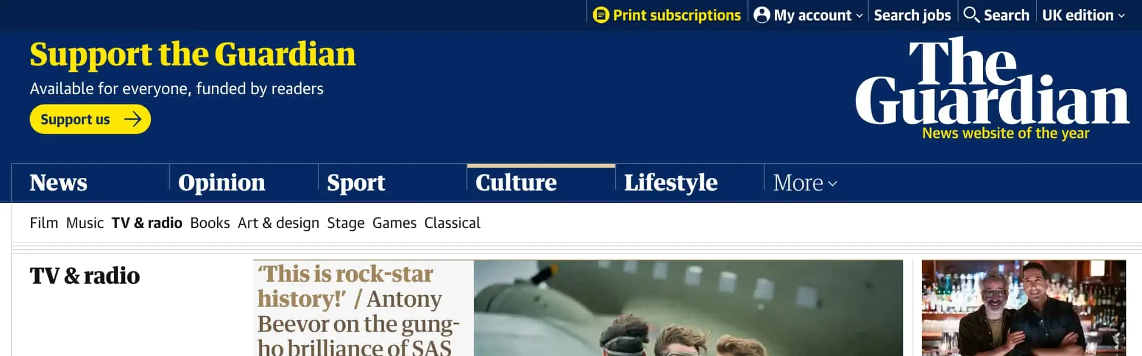
Breadcrumb
Don’t Replace The Primary Navigation Menu : Breadcrumbs aren’t meant to replace, repeat, or distract users from the main navigation. Instead, they should add additional value to the user’s journey by making it easier to explore your content and find relevant information.
Source: https://theguardian.com

Slide 18
Taxonomy & Classification
Taxonomy, at its core, is a science dedicated to the process of classification. While it's a term widely known in biology for classifying organisms, in the world of design and user experience (UX), it takes on a unique and critical dimension.
UX Taxonomy refers to the act of grouping information into relevant sets or categories within digital platforms, such as websites or mobile apps. Its goal is to structure information so that users can navigate and access content in an intuitive and efficient manner.
Vehicles
Shared
Personal
Cargo
Buses
Trains
Planes
Rideshare
Ferry
Car
Bicycle
Helicopter
Plane
Sailboat
Yacht
Plane
Train
Container Ship
Truck

Slide 19

Taxonomy & Classification
Let’s create a taxonomy for a DIY service included in the website of a store using the Post-it method.
The goal is to define clear categories and subcategories to help users navigate the site easily.
Source: https://www.tomazlaven.se/ordsprak-visdomsord-och-citat-om-livet/
Notes:
The final project is: CraftEase is a web application solution developed for home improvement retailers who want to enhance customer engagement directly through their website.
Our goal is to provide your store with an integrated digital service that helps manage DIY workshop registrations, promote project tutorials, and track tool/material availability in real time.
The platform is designed to be seamlessly embedded into your existing website. It is user-friendly, secure, and adaptable to your branding and customer needs. Features include personalized project recommendations, booking management, customer feedback tools, and analytics for store teams.

Slide 20
Taxonomy & Classification
Brainstorm Content
Instruction:
Write one topic per Post-it (e.g., “Material“, “Workshops“, “Videos").
Think about subjects, formats, user needs, and types of content.
Stick them randomly on the board.
Notes:
Step 1: Brainstorm Content (10 min)
🗒️ Instruction:
Write one topic per Post-it (e.g., "Math," "Online Courses," "Teen Learning").
Think about subjects, formats, user needs, and types of content.
Stick them randomly on the board.
Step 2: Group Similar Ideas (15 min)
🗂️ Instruction:
As a group, organize similar Post-its into clusters.
Look for patterns and common themes.
Don’t force a category yet—just group logically.
Step 3: Define Main Categories (15 min)
🔠 Instruction:
Identify 4-6 broad categories from your groups.
Write category names on new Post-its and place them at the top.
Example: Subjects, Learning Levels, Formats, Certifications.
Step 4: Refine Subcategories (15 min)
📌 Instruction:
Place specific Post-its under the most relevant main category.
Merge, rename, or refine as needed.
Example: Subjects → Science → Biology, Chemistry, Physics.
Step 5: Validate & Adjust (15 min)
✅ Instruction:
Ask yourself:
"Where would I find an Intro to Biology course?"
"How do I browse all Certified Courses?"
Adjust if anything is unclear or misplaced.

Slide 21
Taxonomy & Classification
Group Similar Ideas
Instruction:
As a group, organize similar Post-its into clusters.
Look for patterns and common themes.
Don’t force a category yet—just group logically.
Notes:
Step 1: Brainstorm Content (10 min)
🗒️ Instruction:
Write one topic per Post-it (e.g., "Math," "Online Courses," "Teen Learning").
Think about subjects, formats, user needs, and types of content.
Stick them randomly on the board.
Step 2: Group Similar Ideas (15 min)
🗂️ Instruction:
As a group, organize similar Post-its into clusters.
Look for patterns and common themes.
Don’t force a category yet—just group logically.
Step 3: Define Main Categories (15 min)
🔠 Instruction:
Identify 4-6 broad categories from your groups.
Write category names on new Post-its and place them at the top.
Example: Subjects, Learning Levels, Formats, Certifications.
Step 4: Refine Subcategories (15 min)
📌 Instruction:
Place specific Post-its under the most relevant main category.
Merge, rename, or refine as needed.
Example: Subjects → Science → Biology, Chemistry, Physics.
Step 5: Validate & Adjust (15 min)
✅ Instruction:
Ask yourself:
"Where would I find an Intro to Biology course?"
"How do I browse all Certified Courses?"
Adjust if anything is unclear or misplaced.

Slide 22
Taxonomy & Classification
Define Main Categories
Instruction:
Identify 4-6 broad categories from your groups.
Write category names on new Post-its and place them at the top.

Slide 23
Taxonomy & Classification
Refine Subcategories - Group and label the content
Instruction:
Place specific Post-its under the most relevant main category.
Merge, rename, or refine as needed.

Slide 24
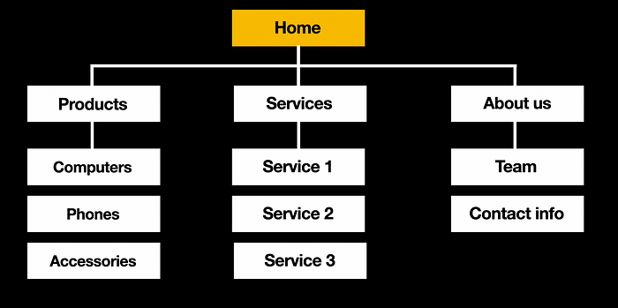
Information Mapping
You have content, and you have groups that make sense. Now the big question – how will users get to this content?
A sitemap is a structured visual representation of a website or app’s content, showing the relationships between parent and child pages. It helps define the hierarchy and navigation flow, making it clear how different sections connect.
This structure, often called a tree structure, ensures logical organization and improves user experience by guiding visitors efficiently through the site.
Source: https://www.mockplus.com/learn/wireframe/website-wireframe

Slide 25
Information Mapping
Create a Sitemap: Based on your research, create a sitemap that details how site pages are connected. This gives a bird's-eye view of the overall structure.
Use this tool to present your sitemap in a diagram : https://app.diagrams.net/
Just another tool: https://www.smartdraw.com/software/tree-diagram-maker.htm?srsltid=AfmBOoo_MX-fU3juv1_FG549CxM11Xj_oQgbQ07DSpbFPAHYkah_MnXi

Slide 26
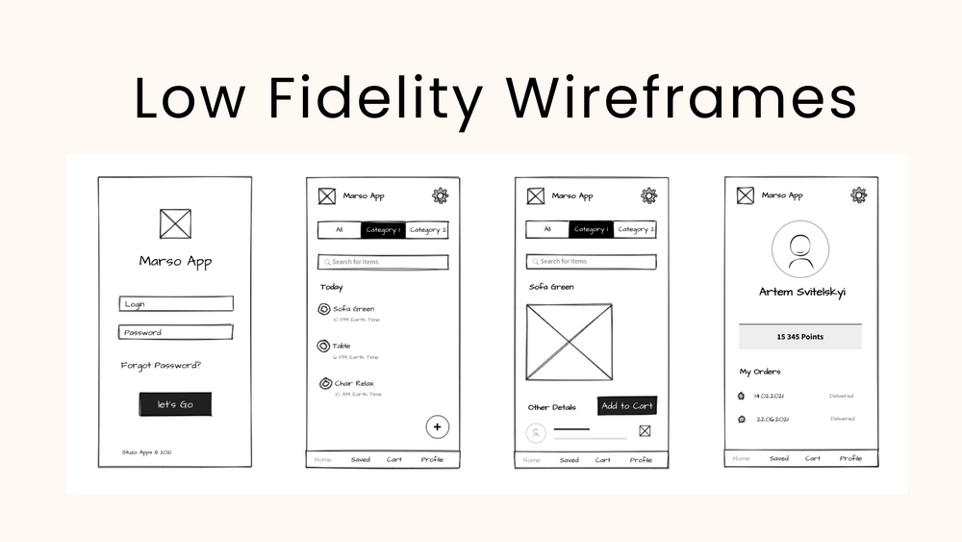
Low-Fidelity Wireframes
A low-fidelity wireframe is a basic sketch of a website or an app's interface. It's a simplified version of the final product, focusing on functionality rather than visual design.
Low-fidelity wireframe designs are often used in the early stages of a project to test early concepts and gather feedback.
Source: https://mockflow.com/blog/wireframing-for-mobile-apps

Slide 27
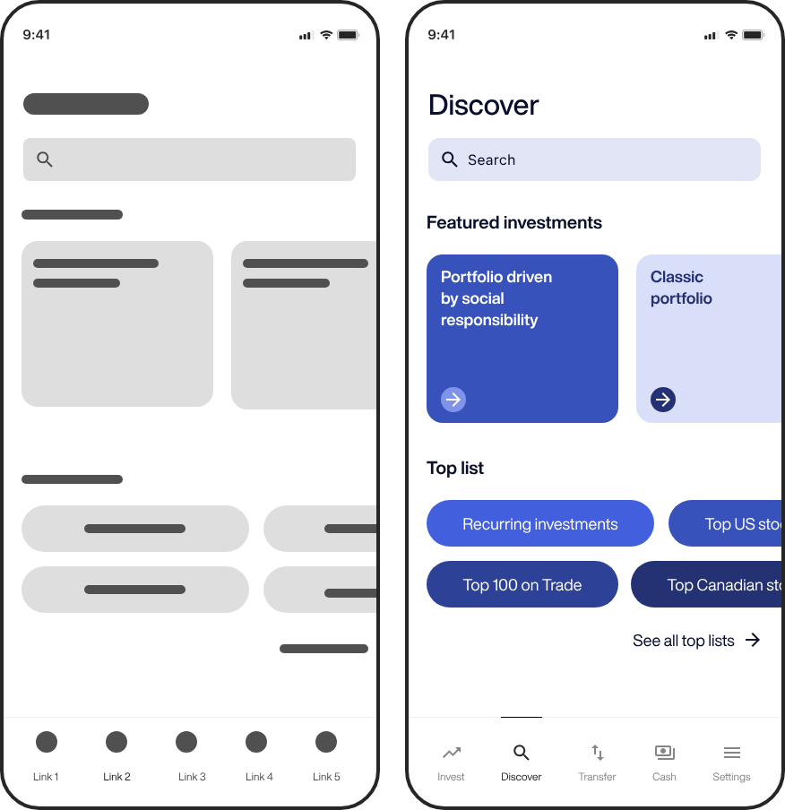
Low-Fidelity Wireframes
Low-Fidelity
High-Fidelity
Source: https://decode.agency/article/mobile-app-wireframe-examples/

Slide 28
Design your app’s home page
The app should allow users to:
Register for DIY workshops
Browse project tutorials
Check real-time tool and material availability
Draw a rough layout (on paper or a digital tool like Figma, Balsamiq (https://balsamiq.com), or wireframing software) based on the information hierarchy established in the previous step.
Use simple shapes (rectangles, circles) to represent different UI elements.
Label each section without using real content or images.

Slide 29
Interactive feedback
Peer Review
Clarity & Structure:
Are all sections easy to understand?
Does the layout follow a logical flow?
Navigation & Usability:
Is the navigation intuitive?
Are important elements (search bar, progress tracker) easy to find?
Consistency & Balance:
Are shapes and sizes consistent?
Do elements have enough spacing for readability?
Creativity & Additional Features:
Does the design feel engaging?
Any suggestions to improve user experience?

Slide 30
A little adjustment
Based on feedback, make at least two changes to enhance your wireframe.

Slide 31
Conclusion
Information architecture is an essential pillar in the design of clear, usable and scalable information systems.
This discipline, which strives to structure, organize and label content in a logical manner, facilitates navigation and access to information in increasingly complex digital environments.
As we move forward into an era where data is multiplying at dizzying speed, information architecture is set to play an increasingly critical role in the creation of intuitive and efficient digital spaces.

Slide 32


Question?
Source: http://www.makeameme.org

Slide 33
RESOURCES
Information architecture in UX: 8 Design principles | Lyssna
What's Information Architecture in UX Design? Ask An Expert
A Beginner's Guide To Information Architecture in UX [2025]
Dan Brown’s — Eight Useful Principles of Information Architecture | by Izharul Mulk | Bootcamp | Medium
L’architecture de l’information : définition, apports, méthodologies. - Optimisation Conversion
Information Architecture Design: A Step-By-Step Guide | by Nick Babich | UX Planet
Designing Better B2B E-Commerce Experiences: Information Architecture…
Breadcrumbs In Web Design: Examples And Best Practices — Smashing Magazine
The Complete Guide to UI Breadcrumbs: With Best Examples
Taxonomy 101: Definition, Best Practices, and How It Complements Other IA Work
Taxonomy UX: What is it, benefits, and what are the best practices?

Slide 34
RESOURCES
An Introduction to Taxonomies | UX Booth
What is Breadcrumb & How It Eases Navigation? (With Examples) - VWO
A tree-based UX planning approach in 5 simple steps | by Nizaretto | UX Collective
What is Navigation in UX Design? | IxDF
Low-fidelity vs. high-fidelity wireframes: the main differences

